Slide 1
National Level Workshop
on 24th June 2019
Under Shyama Prasad Mukherji Rurban Mission (SPMRM)
Badli Cluster District Jhajjar (Haryana)

Slide 2
Financial Progress
Total Cost approved in DPR | Rs. 108.5 Crore
Total CGF Cost | Rs. 29.87 Crore
Total Works in Convergence | 13 | Rs. 78.63 Crore
On-going | 6 | Rs. 13.83 Crore
Completed | 2 | Rs. 1.5 Crore
Not started | 5
Total 100% CGF Works | 4
On-going 100% CGF Works | 3 | Rs. 3.08 Crore
Completed 100% CGF Works | 1 | Rs. 0.50 Crore

Slide 3
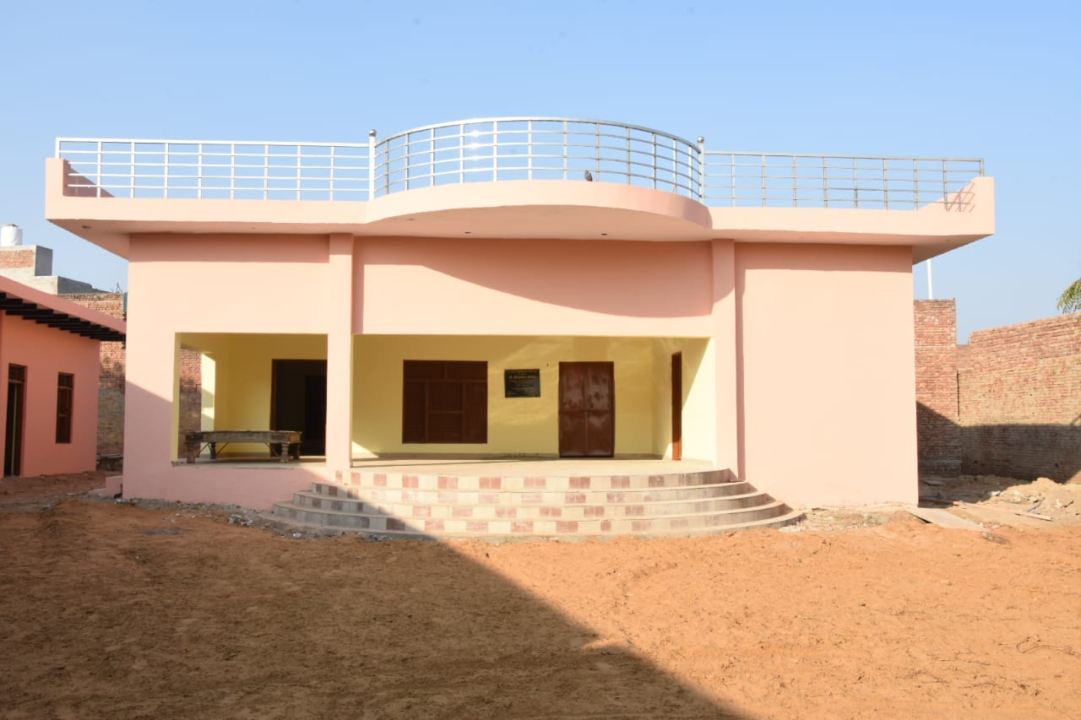
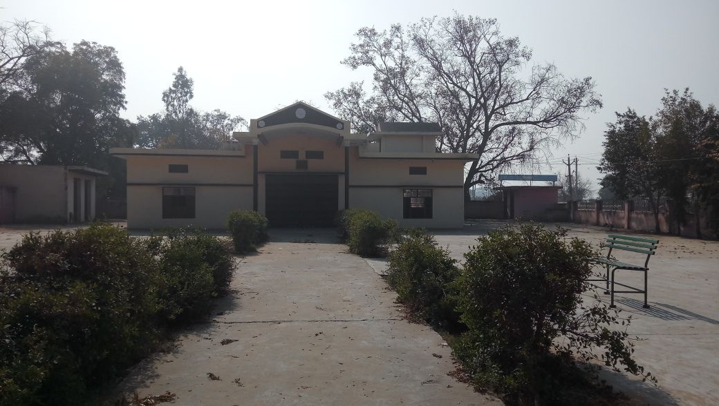
Community Centre in Village Badli and Lagarpur
Badli
Lagarpur
Utility in Public function Gathering of 100-150 peoples, Gram Sabha and Panchayat Meetings, Anganwadi Centres etc.

Slide 4
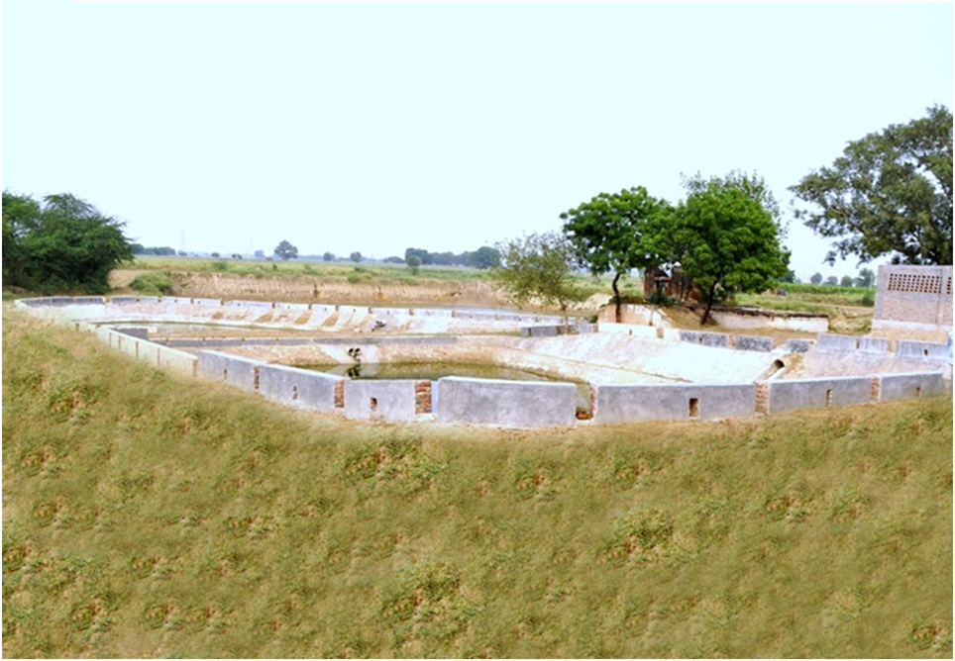
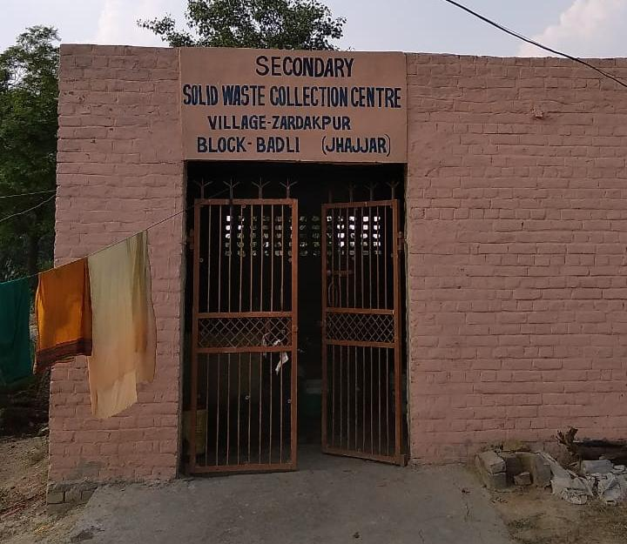
Solid Liquid Waste Management- Village Zardakpur
3 Pond System
Solid Waste Management
State Govt. introduced 3-Pond Stabilization system and Waste Collection Centre as pilot project in Village Zardakpur

Slide 5
CGF Financial Progress
Components | Expenditure
Up-gradation of Schools in 19 villages for repair works | Rs. 45.00 Lakh
Community Centre at village Badli (Rs. 50 lakh) Majri (Rs. 40 lakh) | Rs. 90.00 Lakh
SLWM:- 3-Pond System and Solid Waste Management Shed in 5 GPs | Rs. 112.00 Lakh
Digital Literacy -Smart Class-rooms in 21 Schools in 18 villages | Rs. 85.00 Lakh

Slide 6
Outcomes achieved
Open Defecation Free through Swachh Bharat Mission-Gramin in 2014 was 47% which became 100% by 2017
Transportation improved as 05 more buses were added which increased the frequency for from 3 to 8 times a day, New Bus Q-shelters are constructed at village level
Healthy and clean environment through everyday waste collection by Waste Collection Cart, dustbins installed in all GPs and provisions of drains along the streets of the villages.
Provision of Community Centre for Public function Gathering of 100-150 peoples, Gram Sabha and Panchayat Meeting, Anganwadi Centres in 06 Gram Panchayats

Slide 7
Outcomes we are working
Imparting Digital Literacy through Smart Classrooms with budget of Rs. 1.51 Crore in 21 Schools in 18 villages.
Skill Development project of cost Rs. 15.53 crore to provide training to 6800 youths under 09 courses like Plumber, Carpenter Electrician, fitter, welder etc. for better employment opportunities in the cluster and reach 70% households with one beneficiary in each households.
In agriculture for converting 546 acres of land into Organic Farming. Agro based industries such as oil expellers, bakeries and dairies are being initiated.
Improving Water Supply norm from 45 LPCD to 135 LPCD and upgrading existing supply network.
Villages falling in low-lying areas require pumping system. For proper drainage these will be connected to drain no. 8 passing through the cluster.

Slide 8
Special provision and Role played by elected representatives
Provision of Gram Panchayat land for development works through faster resolution
Motivating people for cleanliness in their locality on separation of dry-wet wastes and less use of plastics.
Providing trainings to farmers with help of Agriculture Department for Organic farming, Agri-waste processing.
Encouraging for green and clean energy i.e. Solar Energy for households

Slide 9
Operation and Maintenance of assets
Utilization of Gram Panchayat funds after handing over of asset
Minimum user charges during ceremonies and functions.
Community Help
Administration Support

Slide 10
Thank You

